Slide 1
Install & Configure VMware Horizon Client
TEIS Digital Workplace

Slide 2
macOS General Information
This document will cover the installation and configuration of the VMware Horizon client. If you do not have the access to download or install this application on your local computer, please contact your local IT department.
The VMware Horizon client is used to connect to your VMware Virtual Machine (VM). There are clients for a wide variety of operating systems. This document will cover the macOS version install.
After the Horizon client is installed and configured, the connection to the Virtual Machine can be initiated directly via the Horizon client.

Slide 3
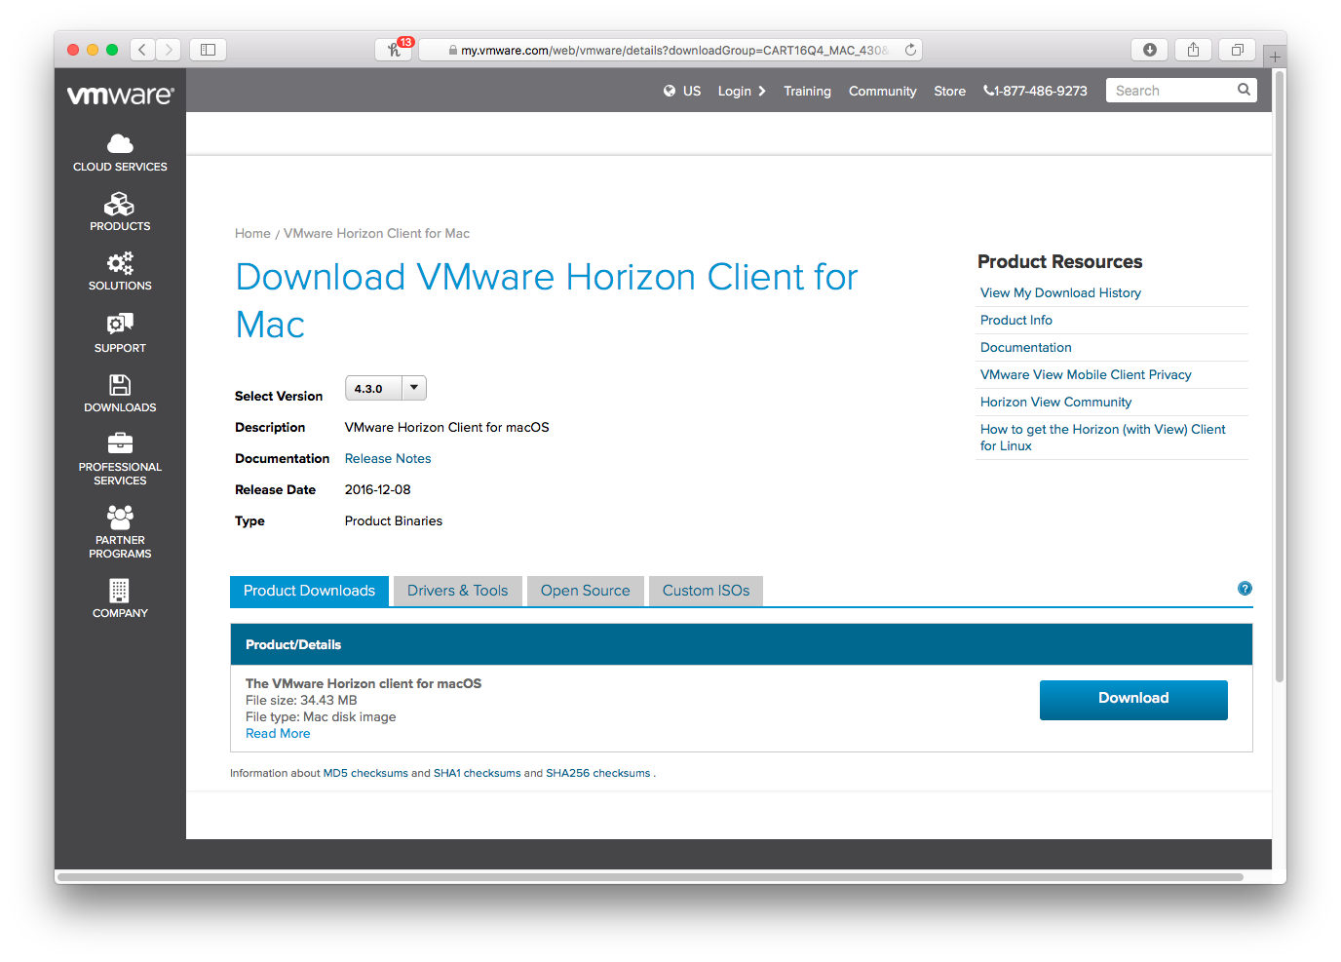
Download
To download the Vmware Horizon client, browse to:
https://www.vmware.com/go/viewclients
Click on the “Go to Downloads” link beside “VMware Horizon Client for Mac”, then click “Download”.

Slide 4
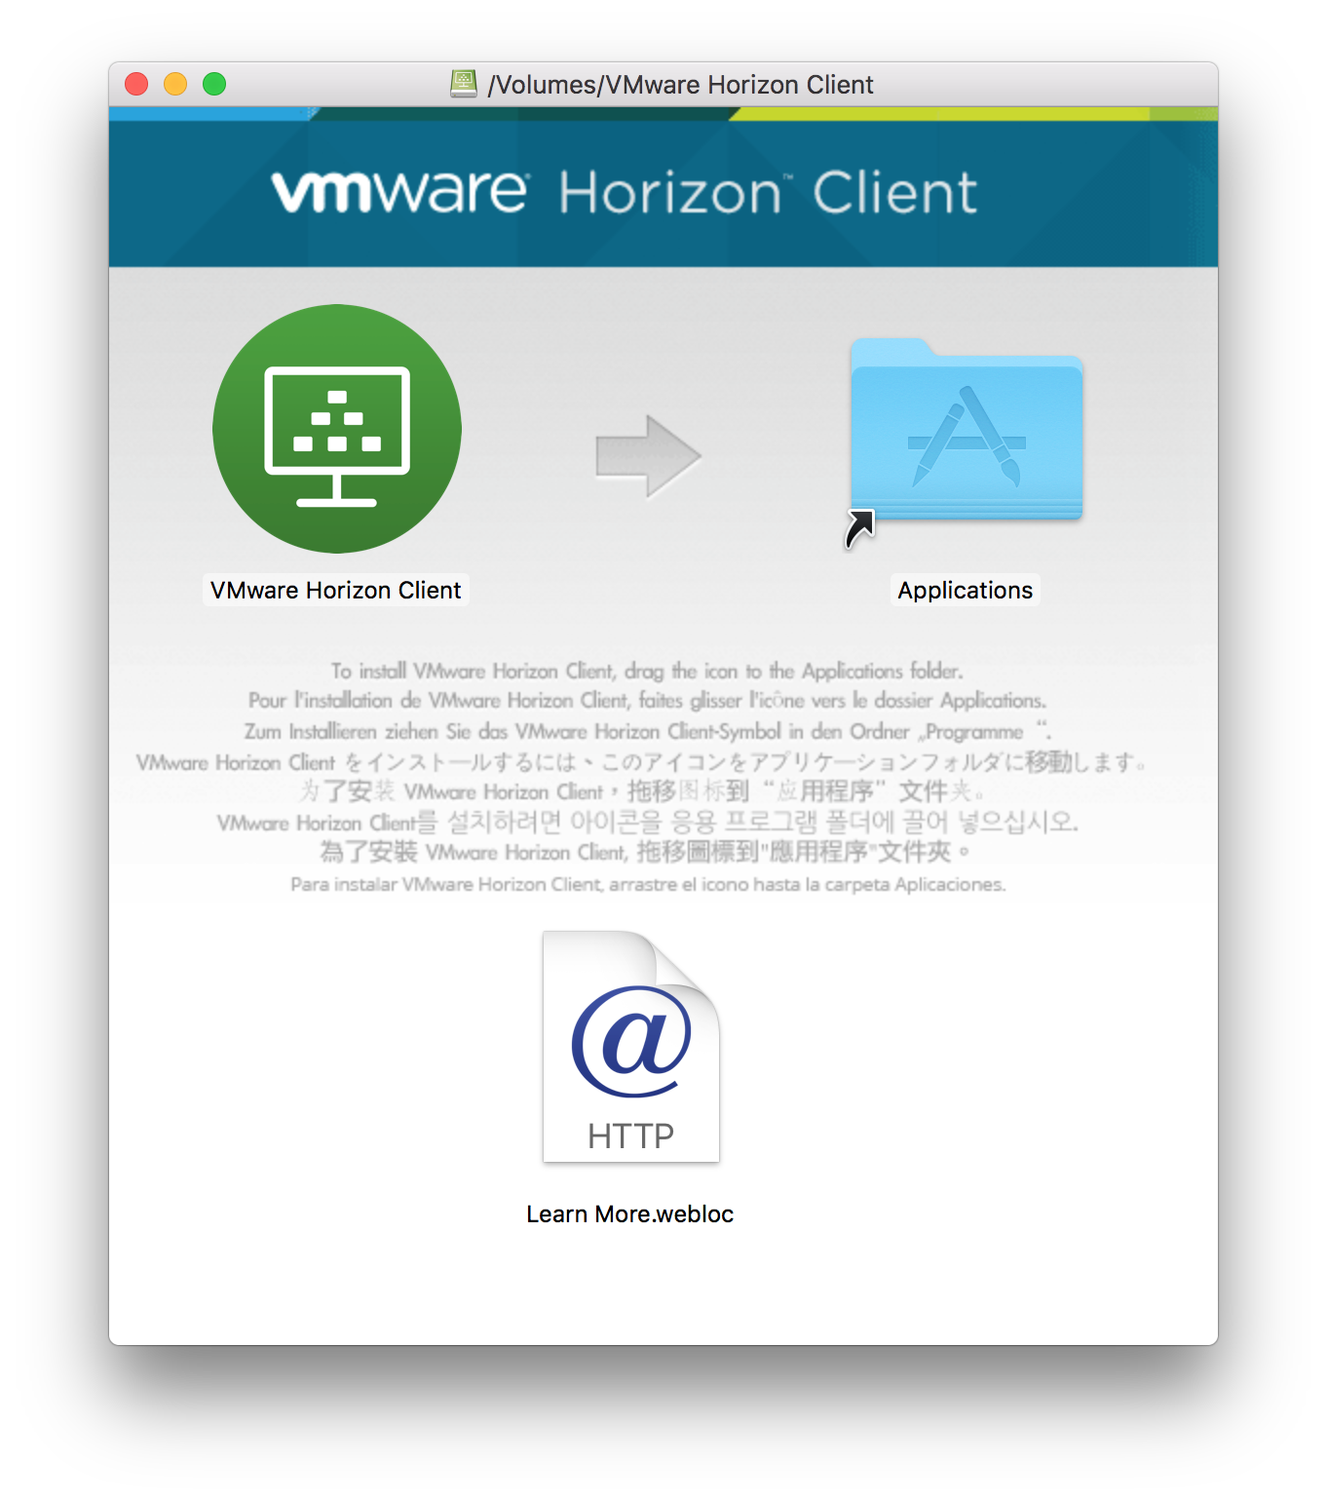
Installation
Double click the file that you just downloaded.
You may be prompted to accept the End User Licensing Agreement.
On the new screen that appears, drag the VMware Horizon Client icon to the Applications icon.
You may be prompted for your admin credentials, if so, enter them and click OK.

Slide 5
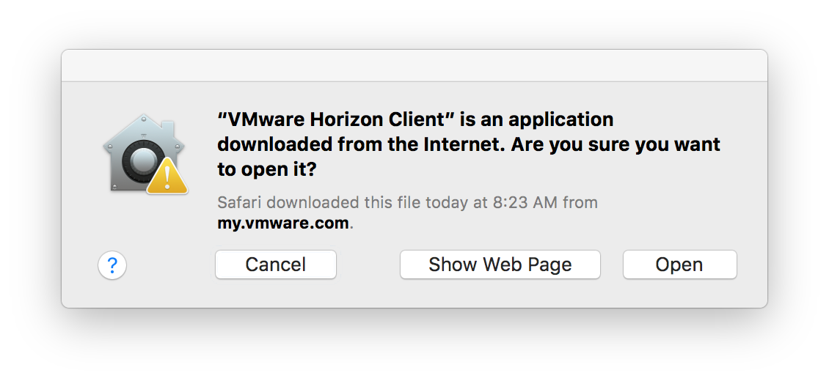
First Launch
You may be prompted to allow VMware Horizon Client to run the first time, as it was downloaded from the internet. Click “Open” to allow it to launch.

Slide 6
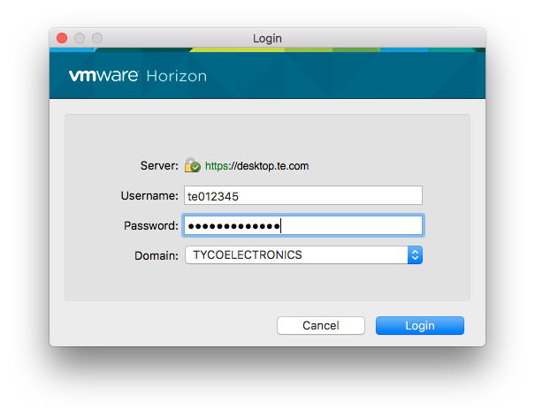
Adding VM Connection
You will need to add a connection to the TE environment before being ale to connect to your VM
Click the “Add Server” button in the main VMware Horizon Client window.
In the name of the Connection Server field, enter: desktop.te.com
Click Connect, you will then be prompted for your credentials. Change the Domain entry to “TYCOELECTRONICS”, and enter your TE credentials in the format shown.

Slide 7
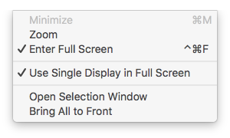
Display Settings
By default, when double click the VM icon in the selection window, the VM will launch in full screen mode, using all of your local monitors.
If you would prefer to use only a single screen, or only a portion of your screen, you can modify these options using the “Window” menu.
The standard green “full screen” widget in the corner of the window will also toggle the “Enter Full Screen” option.

Slide 8
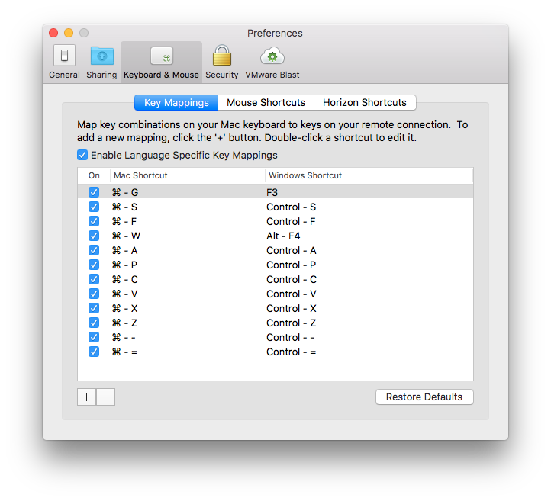
Preferences
You can also use the Preferences screen to configure many common settings, such as:
Automatically sharing your home folder with the VM.
Mapping Mac-centric key commands (such as those using the “Command” key).
And controlling how your mouse/trackpad interact with the VM.

